Slide 1
Web security

Slide 2
The application developers recognized the dangers arising from flaws in web application and established a community called OWASP (Online Web Application Security Project). OWASP -a nonprofit organization- is the standards body for web application security. OWASP community includes corporations, educational organizations and individuals around the world.
After years of testing applications for vulnerabilities, OWASP came up with ten security flaws that make a web application vulnerable.

Slide 3
The ten major threats against web applications are:-
Injection
Broken Authentication
Sensitive data exposure
XML External Entities (XXE)
Broken Access control
Security misconfigurations
Cross Site Scripting (XSS)
Insecure Deserialization
Using Components with known vulnerabilities
Insufficient logging and monitoring

Slide 4
Injection: SQL injection allows attackers to relay malicious code through web application to other systems. This might trick the application in performing and executing process which were not instructed to be run by a valid user/admin. It can result in data loss or corruption, lack of accountability or denial of access. Injection may sometimes lead to complete host takeover.
SQL Injection can be classified into three major categories – In-band SQLi, Inferential SQLi and Out-of-band SQLi.

Slide 5
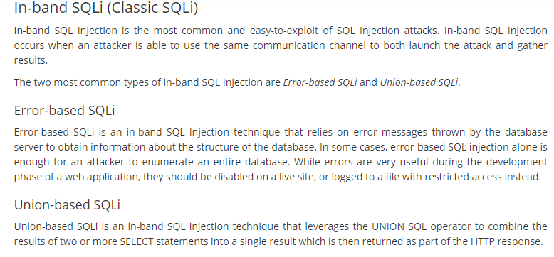

Slide 6
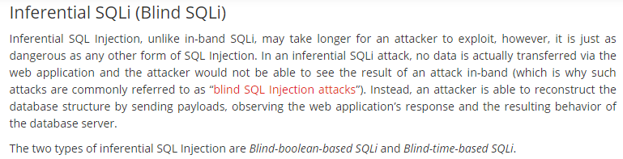

Slide 7
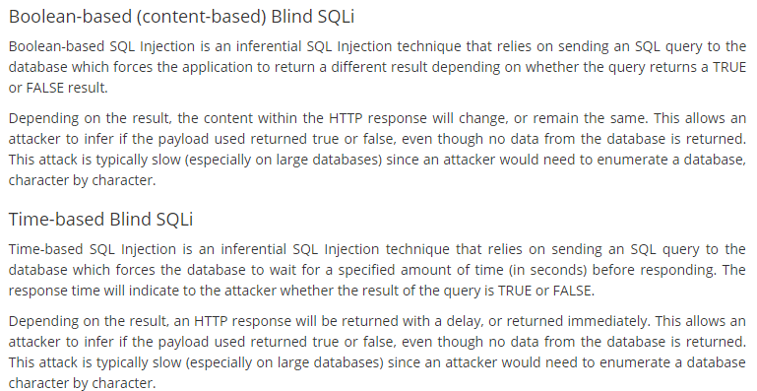

Slide 8
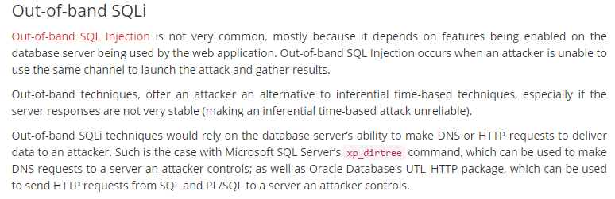

Slide 9
SQL Injection
SQL injection is a code injection technique that might destroy your database.
SQL injection is one of the most common web hacking techniques.
SQL injection is the placement of malicious code in SQL statements, via web page input.

Slide 10
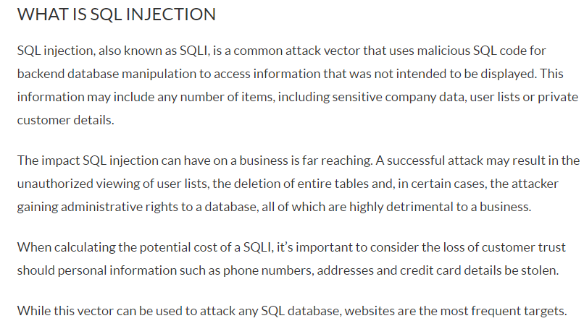

Slide 11
SQL in Web Pages
SQL injection usually occurs when you ask a user for input, like their username/userid, and instead of a name/id, the user gives you an SQL statement that you will unknowingly run on your database.
Look at the following example which creates a SELECT statement by adding a variable (txtUserId) to a select string. The variable is fetched from user input (getRequestString):
Example
txtUserId = getRequestString("UserId"); SQL = "SELECT * FROM Users WHERE UserId = " + txtUserId;

Slide 12
SQL Injection Based on 1=1 is Always True

Slide 13
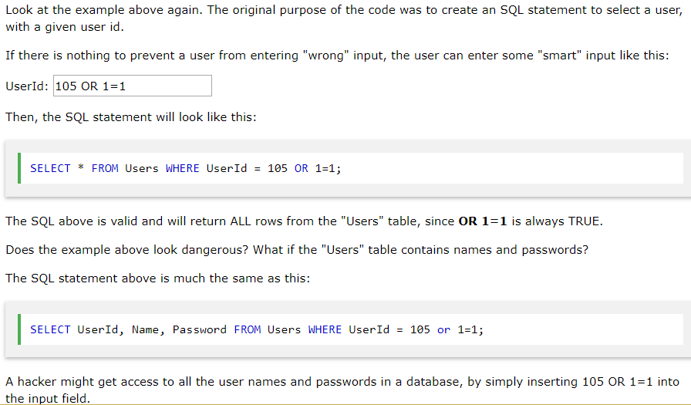

Slide 14
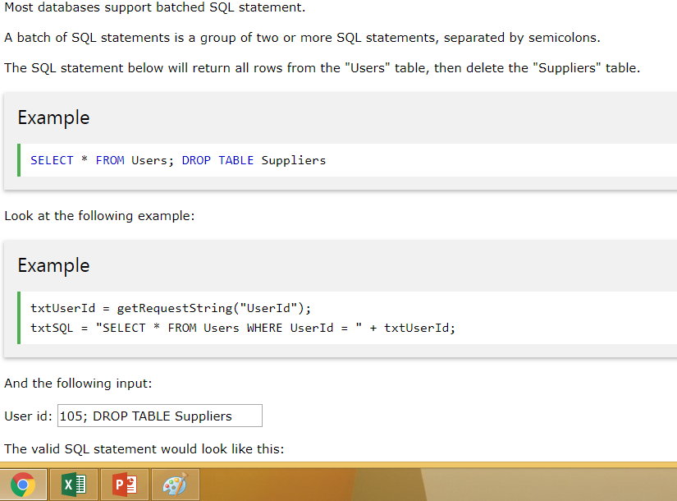
SQL Injection Based on Batched SQL Statements

Slide 15
Result:
SELECT * FROM Users WHERE UserId = 105; DROP TABLE Suppliers;
As a result, the entire supplier database could be deleted.

Slide 16
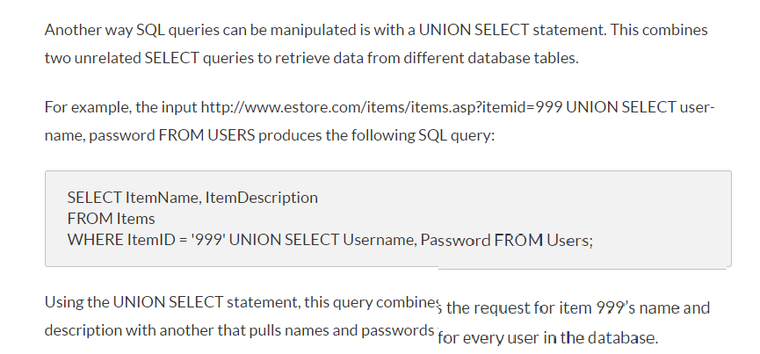

Slide 17
Use SQL Parameters for Protection

Slide 18
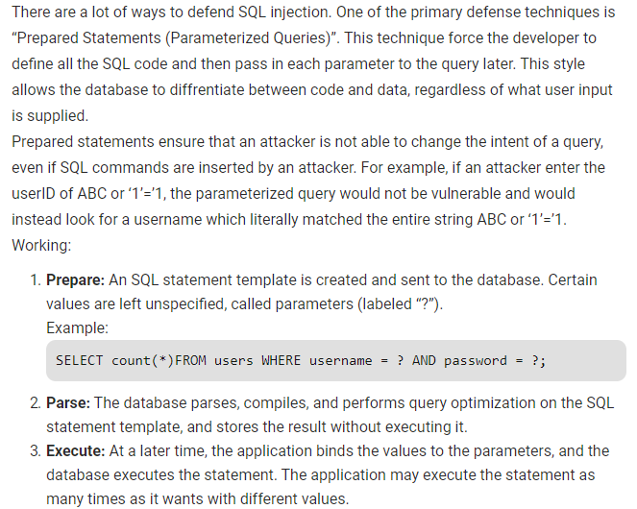

Slide 19
The only proven way to protect a web site from SQL injection attacks, is to use SQL parameters.
SQL parameters are values that are added to an SQL query at execution time, in a controlled manner.

Slide 20
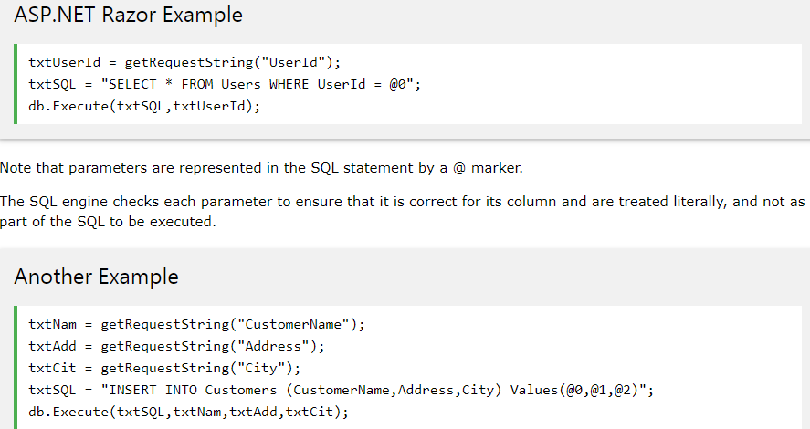

Slide 21
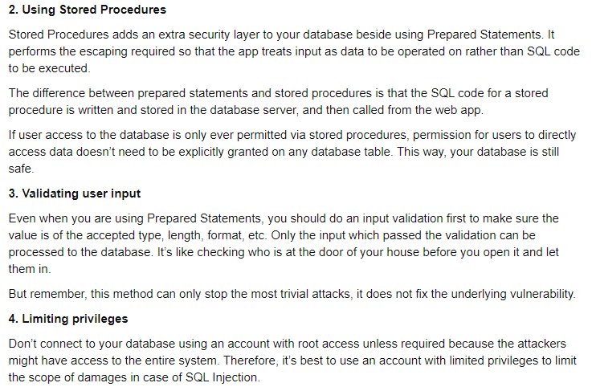

Slide 22
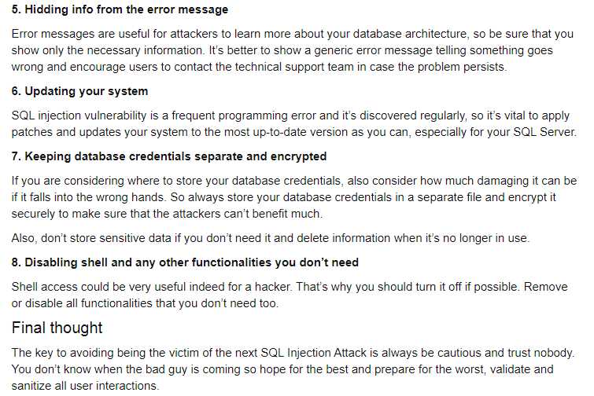

Slide 23
2. Broken authentication and session management:Broken authentication and session management allows attackers to gain details like password, tokens and session IDs which then enable them to login to that users account and impersonate them to carry out transactions. Accounts may be hijacked by attackers by using the active session IDs exposed in URLs.To avoid such attacks user credentials must be passed through encrypted connections and stored using concepts of hashing and encryptions. Timeout of session IDs and authentication must be carried out in order to discourage such threats. Re-authentication in case of forgot password must be done to verify the identity of the user.

Slide 24
3. Cross Site Scripting (XSS): This occurs when a user enters data without input user validation. and this untrusted data is sent to the application without carrying out proper validation (browser side scripting). Next time when other user visits the site or runs the same application, he witnesses the application behaves in a manner in which the attacker wanted it to behave. The malicious script can access cookies, session tokens or any other sensitive information retained by the browser and used with that site. These scripts can also rewrite the content of the HTML page.

Slide 25
Reflected css/Cross Site Request Forgery (CSRF): Also known as one click attack or session riding. This flaw allows the attacker to force an end user to execute unwanted actions on a web application in which they are currently authenticated and send a forged HTTP request along with user authentication details to a vulnerable website. It actually results in an undesired function on the victim’s behalf.Example: Most of the suspicious links you receive via suspicious or unidentified sources through mails.

Slide 26
Other ways to protect your site include but are not limited to the following:
a) utilise built in controls such as Anti-Forgery Tokens, HTTPOnly Cookies, Access-Control-Allow-Origin Headers
b) request users to re-authenticate when performing important actions (e.g. authorising a payment to another bank account)

Slide 27
CROSS SITE SCRIPTING: (XSS)

Slide 28
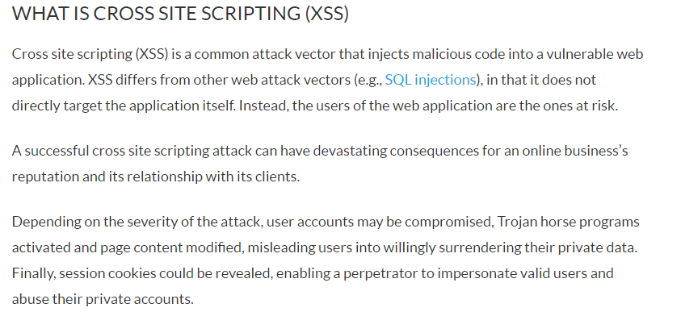

Slide 29
Cross site scripting attacks can be broken down into two types: stored and reflected.
Stored XSS, also known as persistent XSS, is the more damaging of the two. It occurs when a malicious script is injected directly into a vulnerable web application.
Reflected XSS involves the reflecting of a malicious script off of a web application, onto a user’s browser. The script is embedded into a link, and is only activated once that link is clicked on.

Slide 30
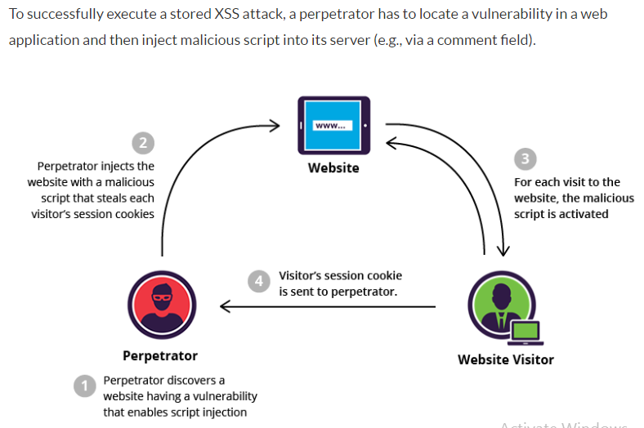

Slide 31
Using the session cookie, the attacker can compromise the visitor’s account, granting him easy access to his personal information and credit card data. Meanwhile, the visitor, who may never have even scrolled down to the comments section, is not aware that the attack took place.
Unlike a reflected attack, where the script is activated after a link is clicked, a stored attack only requires that the victim visit the compromised web page. This increases the reach of the attack, endangering all visitors no matter their level of vigilance.

Slide 32
One of the most frequent targets are websites that allow users to share content, including blogs, social networks, video sharing platforms and message boards. Every time the infected page is viewed, the malicious script is transmitted to the victim’s browser.

Slide 33
STORED XSS ATTACK PREVENTION/MITIGATION
A web application firewall (WAF) is the most commonly used solution for protection from XSS and web application attacks.
WAFs employ different methods to counter attack vectors. In the case of XSS, most will rely on signature based filtering to identify and block malicious requests.

Slide 34
Eg of reflected xss

Slide 35
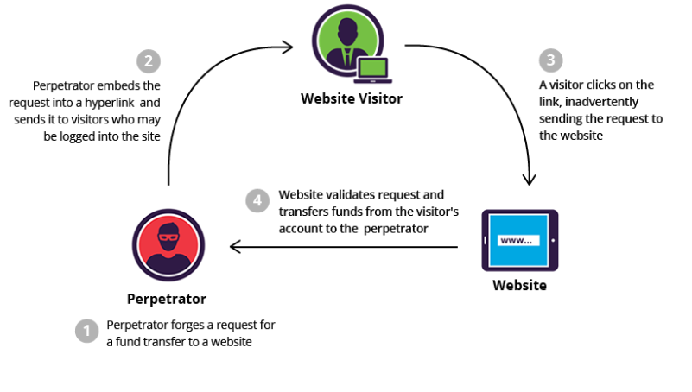

Slide 36
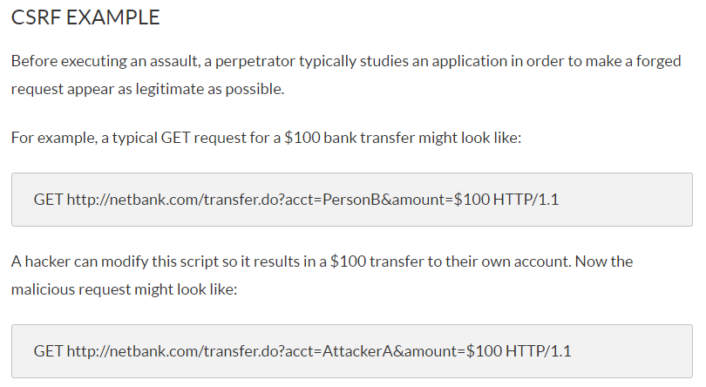

Slide 37
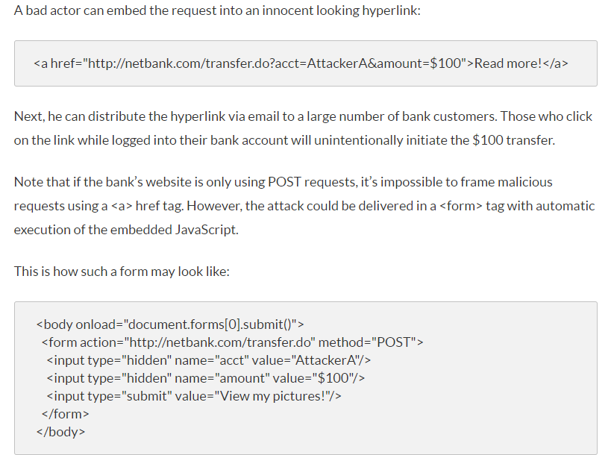

Slide 38
METHODS OF CSRF MITIGATION
Best practices include:
Logging off web applications when not in use
Securing usernames and passwords
Not allowing browsers to remember passwords
Avoiding simultaneously browsing while logged into an application

Slide 39
4. Insecure direct object reference: This occurs when a reference (object, file or database) is exposed to be viewed/modified/used by a user who is not verified for access (authorization). These flaws enable attackers to compromise all the data linked to the modified parameter. Once an attacker finds a way into the application, most likely he’ll will figure a way to dig deeper and compromise any data possible. Example: Access given to all users when only admin should have the access right to view/use/modify data.

Slide 40
This type of attack allows malicious users to access otherwise unauthorised data by manipulating known information such as a URL parameter. This attack is possible because there are inadequate security guards in place to ensure that only authorised users should have access to specific pieces of information. For example, just because my bank account URL is https://mysecurebank/account?id=12345 I shouldn’t be able to see someone else’s account by changing the Id parameter value. And yet, what OWASP is telling us is that this type of attack is still possible! To protect your resource, you should implement thorough Access Control and even go as far as introducing Indirect Reference Maps to hide away real-life keys.

Slide 41
Insecure Deserialization
This threat targets the many web applications which frequently serialize and deserialize data. Serialization means taking objects from the application code and converting them into a format that can be used for another purpose, such as storing the data to disk or streaming it. Deserialization is just the opposite: converting serialized data back into objects the application can use. Serialization is sort of like packing furniture away into boxes before a move, and deserialization is like unpacking the boxes and assembling the furniture after the move. An insecure deserialization attack is like having the movers tamper with the contents of the boxes before they are unpacked.
An insecure deserialization exploit is the result of deserializing data from untrusted sources, and can result in serious consequences like DDoS attacks and remote code execution attacks. While steps can be taken to try and catch attackers, such as monitoring deserialization and implementing type checks, the only sure way to protect against insecure deserialization attacks is to prohibit the deserialization of data from untrusted sources.

Slide 42
5. Security misconfiguration: The application, application server, web server, database server should all have secure configurations. Developers and system administrators need to work together to ensure that the entire stack is configured properly. If a system is compromised through faulty security configurations, data can be stolen or modified slowly over time.

Slide 43
For instance, an application could show a user overly-descriptive errors which may reveal vulnerabilities in the application. This can be mitigated by removing any unused features in the code and ensuring that error messages are more general.

Slide 44
Some examples of security misconfiguration that would allow an attacker to mount an attack:
a) Insufficiently secured web server logs
b) exposing internal code through improperly handled exceptions
c) exposing server/platform information through http headers
This information can be used by an attacker to penetrate the system using known vulnerabilities or data exposed through the attack. Due to the fact that this attack is so broad, it’s hard to provide mitigation advice but I’ve included some suggestions below:
a) ensure all OS and software is up-to-date
b) adopt Secure Development Lifecycle principles
c) make security part of your Change Management process
d) take advantage of Penetration Testing

Slide 45
6. Sensitive data exposure: Sensitive data like credit card details may not be protected in the best possible manner. Attackers might break into such databases and carry out transactions using these data. This includes data and backup of that data. Attackers cannot break the encryption directly, they steal keys, cause middle man attacks or steal clean text data from server or browser. The only way to protecting such sensitive data is by using strong encryption algorithms.

Slide 46
There are a few things you can do in order to mitigate against these risks:
a) encryption at rest and in transit
b) use SSL throughout your site
c) use strong encryption algorithms
d) implement a secure encryption key management

Slide 47
7.Broken access control/ Missing function level access control: Function level authorization must be present on both application and on servers. Most of the web applications verify function level access rights before making that functionality accessible to the user. However, if the access control checks are not performed on the server, hackers will be able to penetrate into the application without proper authorization. Requests need to be verified on both ends to hinder the forgery of requests to access functionality without valid authorization.Example: Anonymous users access private functionality or regular users may use a privileged function if function level access control is not implemented.

Slide 48
For example a web application could allow a user to change which account they are logged in as simply by changing part of a url, without any other verification.
Access controls can be secured by ensuring that a web application uses authorization tokens and sets tight controls on them.
Many services issue authorization tokens when users log in. Every privileged request that a user makes will require that the authorization token be present. This is a secure way to ensure that the user is who they say they are, without having to constantly enter their login credentials.

Slide 49
So this risk is about the absence of proper authorisation which could enable attackers to utilise code that they should not be able to execute. This is fairly wide security risk and there are many ways to protect against it such as:
a) deny access by default and only open up access in a piecemeal fashion.
b) do not write your own security features
c) test your site using an unauthorised user

Slide 50
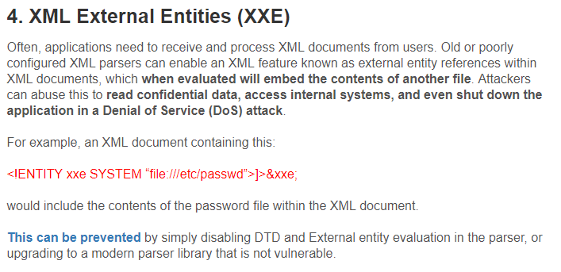
8.
8.using XML External Entities (XXE)

Slide 51
The best ways to prevent XEE attacks are to have web applications accept a less complex type of data, such as JSON**, or at the very least to patch XML parsers and disable the use of external entities in an XML application.
**JavaScript Object Notation (JSON) is a type of simple, human-readable notation often used to transmit data over the internet. Although it was originally created for JavaScript, JSON is language-agnostic and can be interpreted by many different programming languages.

Slide 52
9. Using components with known vulnerabilities: Some tools that are used to develop an application may have security flaws, which are already a known fact and common knowledge to attackers. Implementing such a tool is not advisable as it might in-turn result in giving rise to most of the flaws mentioned above. The attacker knows the weakness of one component so he might have knowledge of what other specific areas of application are vulnerable because of this flaw.Virtually every application has these issues because most development teams don’t focus on ensuring their components/libraries are up to date. In many cases, the developers don’t even know all the components they are using, never mind their versions. Component dependencies make things even worse.

Slide 53
So how do you mitigate against this threat
a) identify and catalogue all components being utilised within an application stack.
b) check for updates and common vulnerability and exposures (CVEs) to the components on a regular basis
c) automate integration testing of these components
d) patch components

Slide 54
10. insufficient logging and monitoring:
While 100% security is not a realistic goal, there are ways to keep your website monitored on a regular basis so you can take immediate action when something happens.
Not having an efficient logging and monitoring process in place can increase the chances of a website compromise.
An audit log is a document that records the events in a website so you can spot anomalies and confirm with the person in charge that the account hasn’t been compromised.
We know that it may be hard for some users to perform audit logs manually. If you have a WordPress website, you can use our free Security Plugin which can be downloaded from the official WordPress repository.

Slide 55
Hackers methodology
Fingerprinting/ reconnaissance
Scanning
Gaining access
Maintaining access
Clearing the tracks.

Slide 56
Reconnaisance:This is the first step of Hacking. It is also called as Footprinting and information gathering Phase. This is the preparatory phase where we collect as much information as possible about the target. We usually collect information about three groups,
Network
Host
People involved
There are two types of Footprinting:
Active: Directly interacting with the target to gather information about the target. Eg Using Nmap tool to scan the target
Passive: Trying to collect the information about the target without directly accessing the target. This involves collecting information from social media, public websites etc.

Slide 57
Scanning:
Three types of scanning are involved:
Port scanning: This phase involves scanning the target for the information like open ports, Live systems, various services running on the host.
Vulnerability Scanning: Checking the target for weaknesses or vulnerabilities which can be exploited. Usually done with help of automated tools
Network Mapping: Finding the topology of network, routers, firewalls servers if any, and host information and drawing a network diagram with the available information. This map may serve as a valuable piece of information throughout the hacking process.

Slide 58
3. Gaining Access:
This phase is where an attacker breaks into the system/network using various tools or methods. After entering into a system, he has to increase his privilege to administrator level so he can install an application he needs or modify data or hide data.
4. Maintaining Access:
Hacker may just hack the system to show it was vulnerable or he can be so mischievous that he wants to maintain or persist the connection in the background without the knowledge of the user. This can be done using Trojans, Rootkits or other malicious files. The aim is to maintain the access to the target until he finishes the tasks he planned to accomplish in that target.

Slide 59
5. Clearing Track:
No thief wants to get caught. An intelligent hacker always clears all evidence so that in the later point of time, no one will find any traces leading to him. This involves modifying/corrupting/deleting the values of Logs, modifying registry values and uninstalling all applications he used and deleting all folders he created.

Slide 60
Types of hackers
Black hat
White hat
Grey hat

Slide 61
Web Application Hacking Methodology
Web application hacking is not just about using automated tools to find common vulnerabilities. It is indeed a methodological approach that, if followed, would help reveal many more flaws and potential security vulnerabilities. The following section describes the systematic approach and process to be followed for testing the security of web applications.

Slide 62
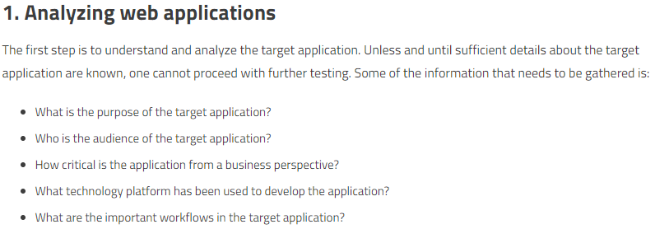

Slide 63
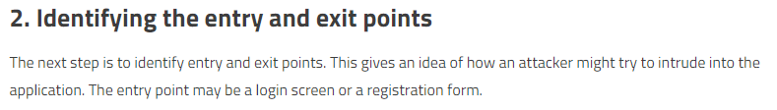

Slide 64
3. Breaking down the components
This step involves breaking down application components. It’s vital to know what components are used within the application, whether it involves an additional application server and/or database server.

Slide 65
4. Testing manually for vulnerabilities
Using tools like BurpSuite, Paros, ZAP, and others, manual security testing can be performed. This mainly involves intercepting potential HTTP requests, modifying and tampering with the parameter values, and then analyzing the application’s response.

Slide 66
5. Automated security scanning
Tools like IBM AppScan, Fortify, and Acunetix are some of the commercial tools available for automated web application security testing. They perform a comprehensive scan on input parameters across the application and check for various vulnerabilities.

Slide 67
6. Removing false positives
Automated scanning tools may produce false positives. Hence it is important to manually verify any vulnerability found during scanning and remove false positives if any.

Slide 68
7. Reporting with remediation
A certain security issue might appear as merely a missing functionality to a developer. Hence, it is critical to prepare a vulnerability report with all necessary artifacts and proof-of-concepts in order to make the developer community understand the severity of the vulnerabilities identified. It is also necessary to suggest a fix recommendation for any identified vulnerability.

Slide 69
THE DIFFERENT WEB HACKING TOOLS
Nmap
Openssh
Wireshark
Nessus
Kali linux
Angry ip scanner
Cain and abel
Ettercap
Burp suite
Metasploit
Etc

